Slide 1
Digital University
Skill Based Assessment (SBA) Orientation Deck
Notes:
Place the audio notes for this slide here

Slide 2

Agenda
About the Skill Based Assessment(SBA)
SBA Profiling Model
SBA
How to take the hands-on problems?

Slide 3

About the Skill Based Assessment(SBA)
Skill Based Assessment (SBA) helps to evaluate associate in a skill or a skill Cluster. It is very important for an associate to be proficient in skills required to perform his role better.
Associates are requested to take this assessment in a proctored environment. Based on the course code, please register/enroll in the learning portal to take this assessment
Associates have to take up the assessment using Virtual Lab environment (VDI)- VM ware Horizon
Details related to venue to take up the SBA will be given to the Associates as part of the mailer, triggered from One Communicator

Slide 4
SBA Profiling Model
SBA
Level 1 - Skill level Profiling
(Implementing the solutions for the case study)
Total profiling duration – 4 hours
In this Assessment, a case study will be provided to test the Associate’s skill and problem solving capability using appropriate features.

Slide 5
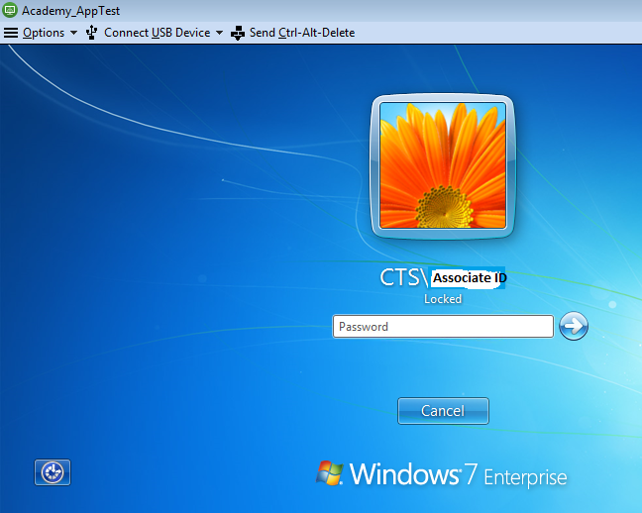
How to take the hands-on problems?
Once you enter the Exam Hall, you will be provided with the Assessment URL to take up the exam.
Use Cognizant Network credential to login the Assessment environment as below :
Please note:
After logging into the Assessment environment , start the assessment
Read the Instructions carefully provided in the Case study
Associate needs to submit the test after he/she uploads the case study in moodle.
On completion of the assessment the system should mandatorily be logged off. It should not be left locked.
Hands-on environment is part of VDI.
During the course of assessment, DO NOT close the browser window and do not click on HOME button/any other link.

Slide 6
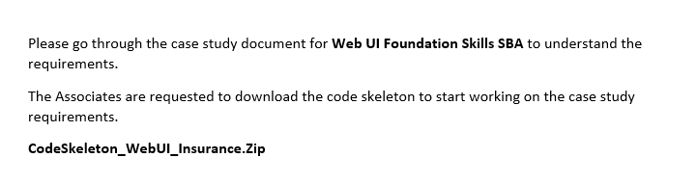
Assessment Page
Please note :
Associates are requested to download the code skeleton and case study document.
Instructions to start the project is available as part of the “Case study document”
Solve the case study and upload in the moodle
Necessary software's are available @ VDI Desktop -> Academy Digital Folder
Mongodb is available @ “C:\Program Files\MongoDB\Server\3.2\bin“
Use the GitBash instead of the command prompt as given in the case study requirement document.

Slide 7
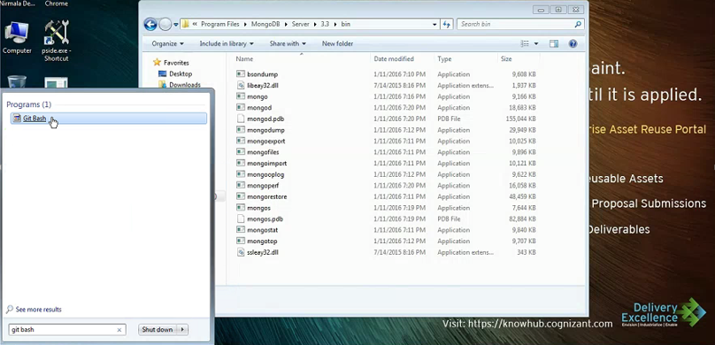
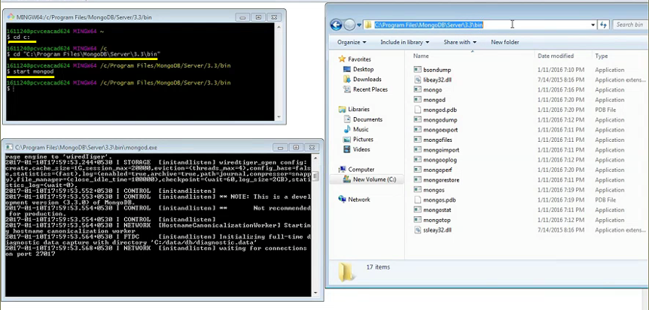
How to start mongodb server?
Step 1: Open GitBash from Start Programs -> Run command
Step 2: Change directory to C: and the path where MongoDB
Server exists as below: ( check MongoDB path, version
may vary based on system e.g.: 3.2 or 3.3 )
userid@machine ~
$ cd /c/”Program Files”/MongoDB/Server/3.3/bin
Step 3: Create the data folder C:/data/db
Step 4: Start the mongodb server
userid@machine /c/Program Files/MongoDB/Server/3.3/bin
$ ./mongod.exe --dbpath C:/data/db
Alternatively we can also use command “start mongod” but this might give errors if db path is not set.

Slide 8
How to start the project?
Step 1: Open GitBash from Start Programs -> Run command
Step 2: Create a new folder “workspace” inside C Drive,
Download the “code skeleton”, save it in the folder,
“C:\workspace” and unzip the code in this folder
Step 3: Inside the GitBash , navigate to the path where the code skeleton is downloaded i.e. C:\workspace\SouthernBankPrj_Skeleton
userid@machine ~
$ cd c:
userid@machine /c
$ cd “workspace/SouthernBankPrj_Skeleton“
userid@machine /c/workspace/SouthernBankPrj_Skeleton
$ node app
Sept 4: Start the project : Open the browser and type “http://localhost:3000”.
You should now be able to see the home page of the application. Cross verify listening port no(3000) in the code in the corresponding js file (e.g.: server.js/app.js)

Slide 9
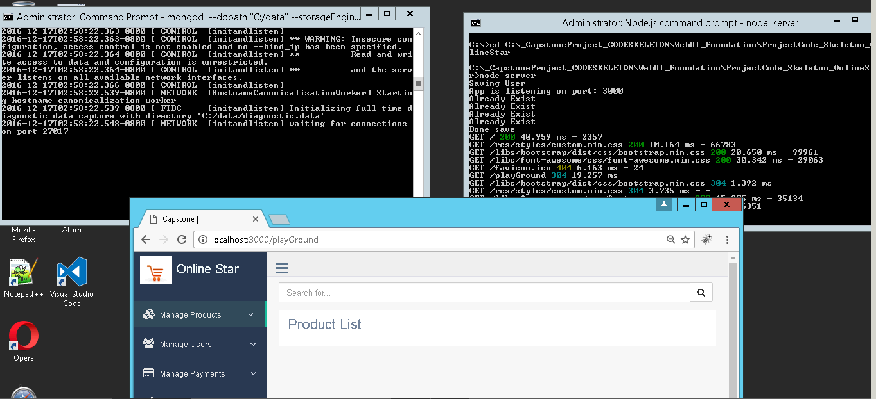
For Sample
Start nodejs server
Start mongodb server
Run the application

Slide 10
Reference Links:
Digital 301 – Responsive Web UI Developer SBA
Click here to access the Learning materials available
Click here to access the capstone projects
Digital 301 – Web UI Developer Server-side Scripting SBA
Click here to access the Learning materials available
Click here to access the capstone projects
Digital 301 – core web UI Developer SBA
Click here to access the Learning materials available
Click here to access the capstone projects

Slide 11
Reference Links:
Digital 301 – Angular JS1x SBA
Click here to access the Learning materials available
Click here to access the capstone projects
Digital 301 –Angular 2 SBA
Click here to access the Learning materials available
Click here to access the capstone projects
Digital 301 –Advanced Java script SBA
Click here to access the Learning materials available

Slide 12
VDI – Software path details
VDI – Software path details
Error Handling

Slide 13
Thank You
Notes:
Place the audio notes for this slide here

